Slide 1







Software University: Learning Program
Become a Software Engineer and Start a Job
SoftUni Team
Technical Trainers
Software University
https://softuni.bg

Slide 2
Table of Contents
Welcome to SoftUni
SoftUni Partners
SoftUni Trainers
Learning Paths and Opportunities

Slide 3
Questions?
sli.do
#fund-common

Slide 4
The SoftUni Family
Quality Digital Education for Thousands

Slide 5
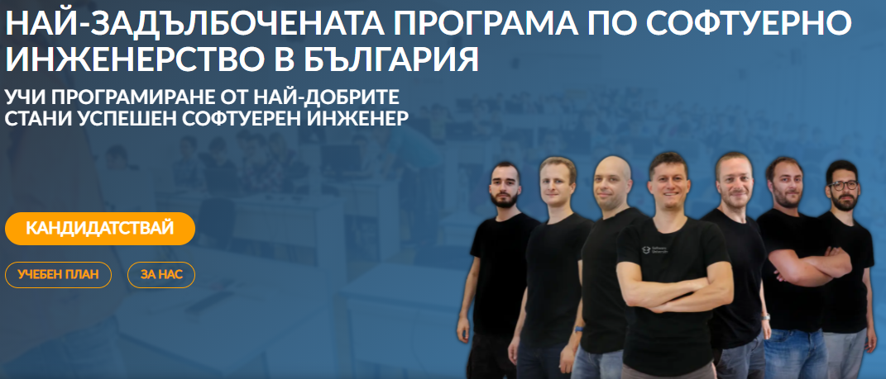
Software Engineering Learning Program
The "Software University" learning program @ SoftUni
Become a professional software engineer in ~ 1-2 years
Professions:
C# / .NET Web Developer
Java & Spring Web Developer
JavaScript Web Developer
Python & Django Web Developer
Curriculum: https://softuni.bg/curriculum

Slide 6

SoftUni Partners
Tech Companies, Who Support SoftUni

Slide 7












SoftUni Diamond Partners

Slide 8


Educational Partners

Slide 9
Coca-Cola HBC – Bulgaria
Coca‑Cola HBC is one of the world's largest bottlers of brands from the Coca‑Cola company
CCHBC started operations in Bulgaria in 1992 and since then is one of the biggest contributors to the local economy
Global company with over 30 thousand engaged people
https://bg.coca-colahellenic.com

Slide 10

CreateX
Site design
Website optimization – SEO
Online advertising – PPC
Social media marketing
Copywriting
Creative concept and design
https://createx.bg/

Slide 11
SmartIT
16+ years of development of technical solutions for financial companies
ERP Systems
Fintech solutions
Server Administration
Offices in Sofia (2), Plovdiv and Kiev (Ukraine)
Looking for Devs & QAs
https://www.smartit.bg

Slide 12
Draft Kings
Award-winning sports betting solutions
iGaming platform
Looking for developers, mostly with JS and .NET
https://de.draftkings.com/

Slide 13
SuperHosting
The largest hosting company in Bulgaria
Hosting & Domains
WordPress Hosting
VPS Servers
SSL Certificates
E-Commerce
Top-quality support
Top-qualified team
Offering a complete solution
Leading technical equipment
https://www.superhosting.bg/

Slide 14

Indeavr
Business and technology services company
Business application development
Infrastructure services
Collaboration services
Looking for trainee and junior .NET Developers
https://www.indeavr.com/en/careers

Slide 15

Taulia
Global FinTech platform
Microservices, CI/CD, Autonomous teams
Java-based stack, open to developers with any tech background
https://taulia.com/company/careers/

Slide 16



Software Group
Integration solutions for financial institutions
Provide digital transformation
https://www.softwaregroup.com/
Discovering Potential
Driving Innovation
Unlocking Opportunities

Slide 17

Postbank
One of the top banking institutions in Bulgaria
Employer of the year for 2017
Member of the Eurobank Group with € 58 billion of assets
Serious investments in digitization
The first bank credit botchat – EVA
https://www.facebook.com/evapostbank
https://www.postbank.bg/Za-nas/Careers

Slide 18

Schwarz IT
IT service providers for the divisions of the Schwarz Group
Responsible for the provision of IT infrastructure platforms and business applications
Support education and invest in development of business and IT professionals
https://it.schwarz/en/it-hubs/bulgaria

Slide 19

PokerStars
Product company home of PokerStars, PokerStars Casino and PokerStars Sport
Global engineering team
Industry-leading products
Java, JS, React, Kubernetes, AWS and many more
https://pokerstarscareers.com/

Slide 20
PharVision Capital
Founded in 2020 in Chicago
Provide superior uncorrelated investments returns using statistics and AI/ML methods
Sources un/structured datasets, sound economic and financial principles, and advanced ML techniques to capture in the equity markets
https://www.pharvision.ai/

Slide 21

The Trainers
The Trainers for the Software Engineering Program

Slide 22
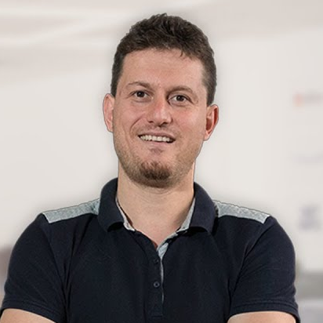
Svetlin Nakov, PhD
Co-Founder of SoftUni
Training & Inspiration Manager @ Software University (SoftUni)
20+ years as software developer
10+ years experience as trainer
Author of 8 programming books
Speaker at hundreds of events
Web site & blog: nakov.com

Slide 23
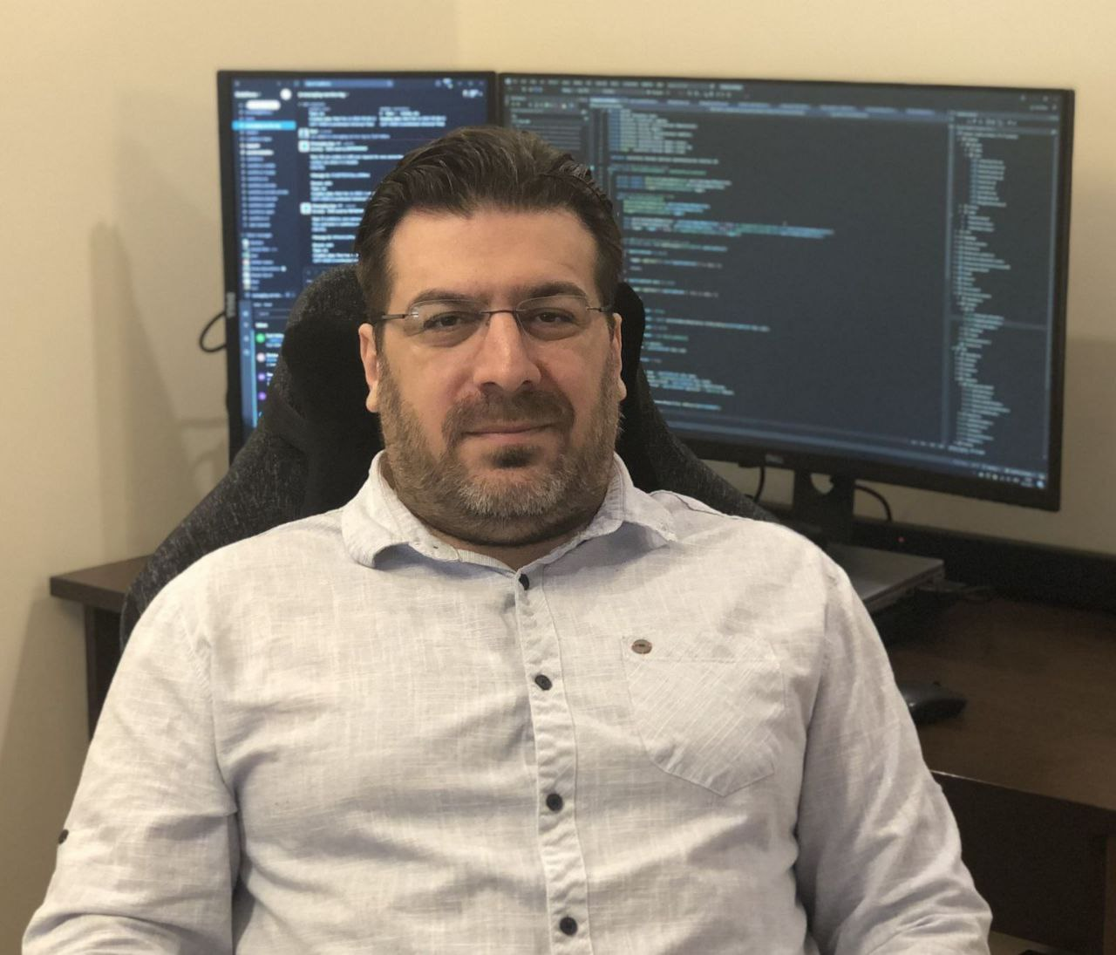
Georgi Inkov
C# Web Developer
8 years experience in .NET ecosystem
Graduated @ first class of SoftUni
Worked in Cashwave, Vivacom & Fourth
Now works as a back-end developer
@ ScaleForce (part of Excitel EOOD)

Slide 24
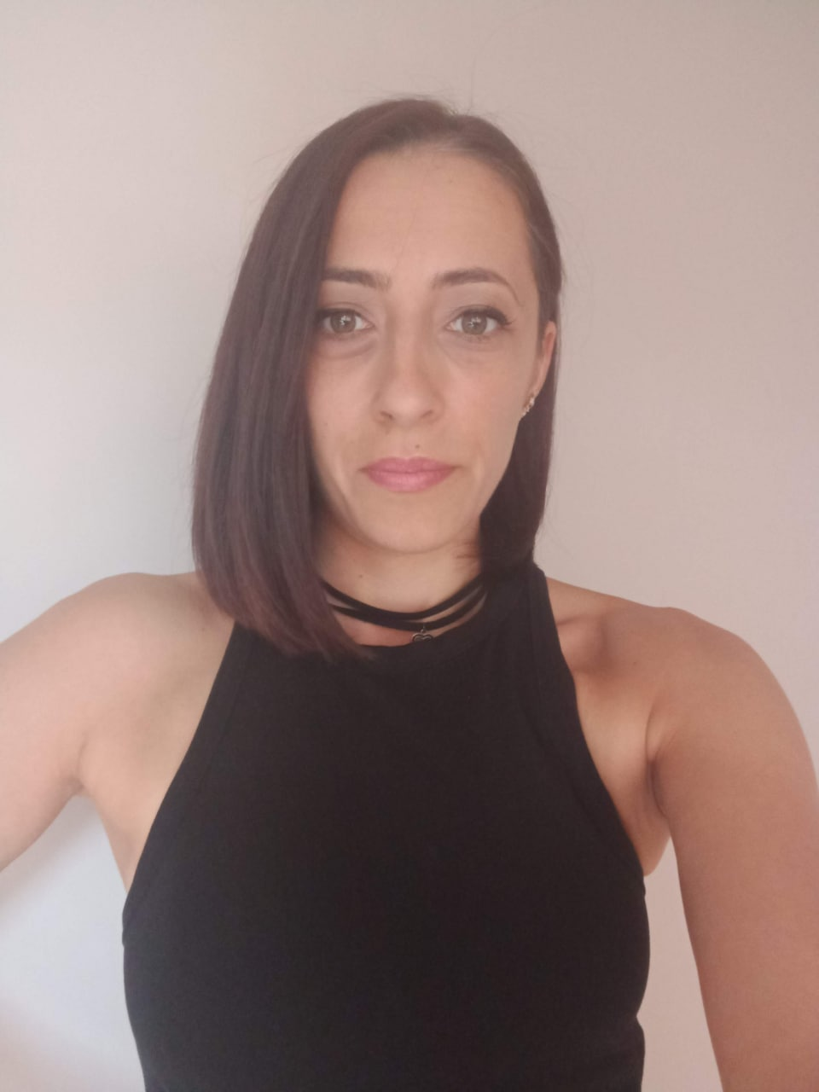
Veronika Vaneva
Former Training Director @ SoftUni
Project Manager @ Information Services AD
Former Program Director @ Motion Software
Graduated from the Medical University - Pleven
Interests in Java, C++ and Unity

Slide 25
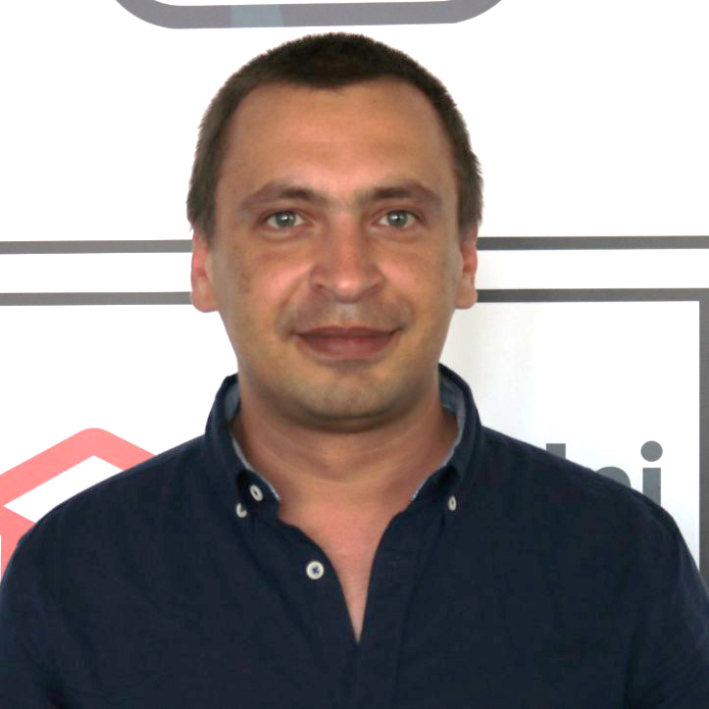
Todor Stoyanov
Trainer and top student @ SoftUni with Java and JavaScript
Junior JavaScript Developer
Experience as System Administrator

Slide 26
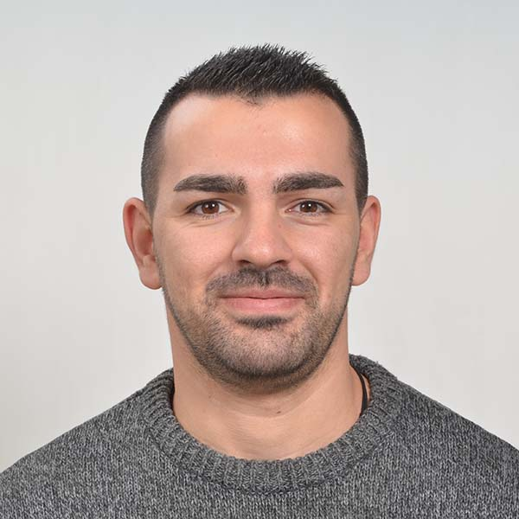
Mario Zahariev
Top student @ SoftUni
Master of Cyber Security
3+ years of experience on Python
Interested in JavaScript, Artificial Intelligence and Go
Involved in researches related to artificial intelligence and machine learning

Slide 27
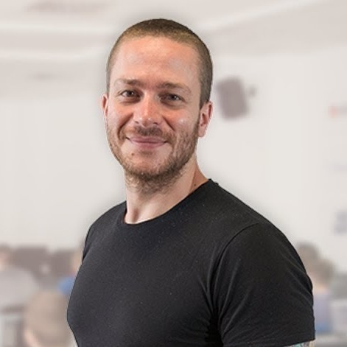
Ivaylo Kenov
Various job titles at the same time:
CTO @ SoftUni
Technical Trainer @ SoftUni
Creator of the most detailed software architecture course
Mathematical competitions champion
Contacts:
https://github.com/ivaylokenov
https://linkedin.com/in/kenov

Slide 28
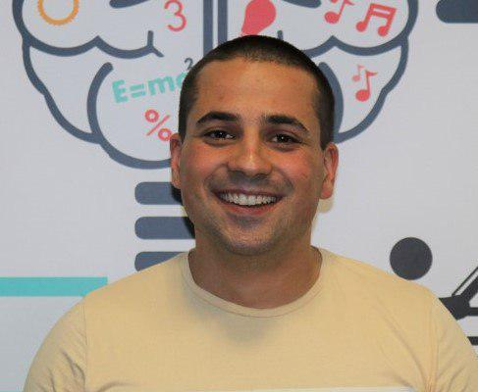
Martin Paunov
Java Developer @ VMware
Experience with Java, C++, C#
Technical Trainer @ SoftUni
Interested in Astrophysics

Slide 29
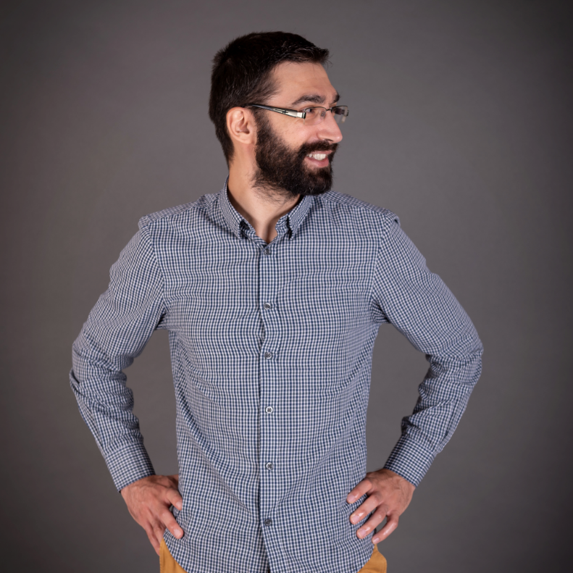
Viktor Kostadinov
Senior technical trainer with 5 years experience in the IT field
Head of the R&D Unit at Software University
Former Director of the Education Department
JavaScript enthusiast

Slide 30
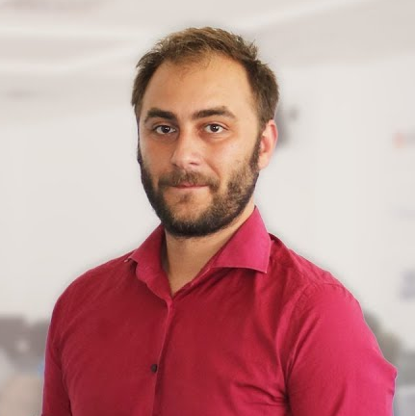
Doncho Minkov
Technical lead, Architect and DevOps @ SoftUni
10+ years of experience as a Technical Trainer
Front-end developer by heart
Software developer by need
Experienced in Django, Node.js, .NET and others
Fluent in Python, JavaScript, C#, Java, C++
"30 under 30" – Forbes 2017 - Education

Slide 31
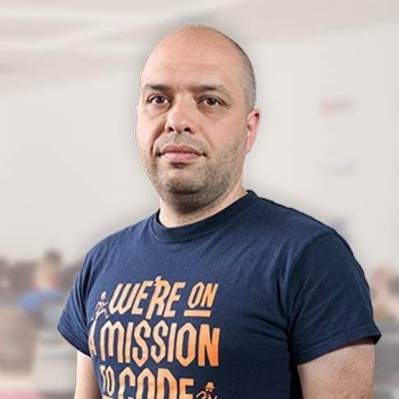
Stamo Petkov
Head Of Department at Information Services Plc.
Worked with various technologies
.NET and C#, BASIC, Pascal, Object Pascal, PHP
More than 15 years of experience
Experienced Lecturer
C# Basics and ASP.NET MVC @ Softuni

Slide 32
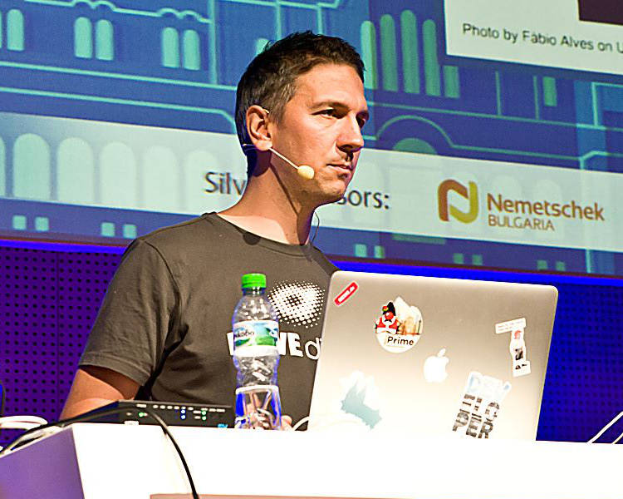
Lachezar Balev
Software engineer with 19+ years of real experience with different projects
Started developing with Java in the year 2000 in the form of J2SE 1.2
Works in REWE Digital Bulgaria on an architecture focused on microservices
Uses Java, TypeScript and Kotlin in his daily tasks
Rides a motorcycle and climbs mountains in his spare time
Personal website: http://balev.eu/

Slide 33
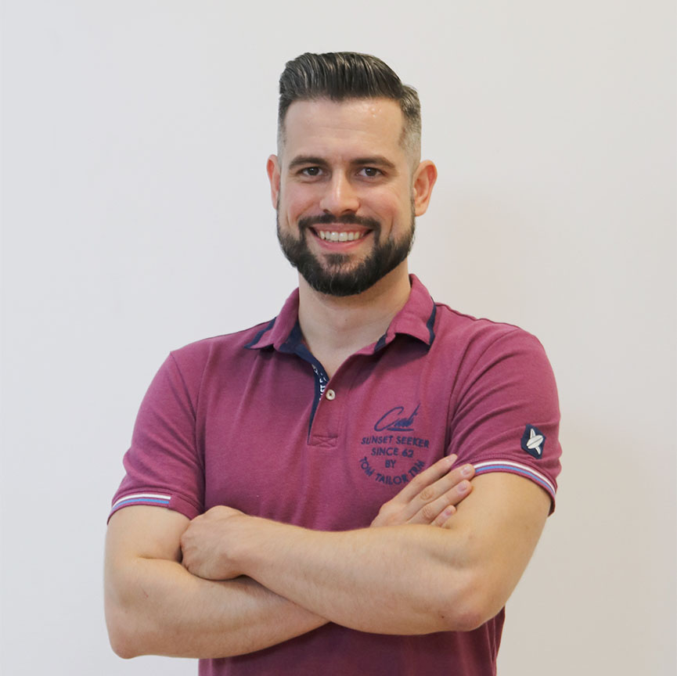
Ivaylo Papazov
Senior Software Engineer at Payhawk
Trainer at SoftUni
Experience with JS, React, Node.js, MongoDB
6+ years professional experience

Slide 34
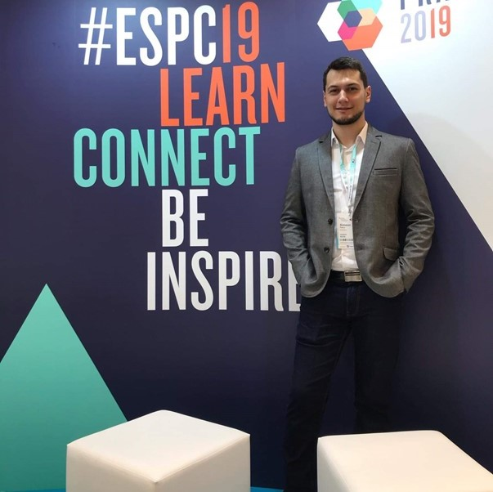
Simeon Petrov
Front-end Developer @ Blubito AG
Passionate about Vue, JavaScript & CSS
Experienced with Vue, React, Gatsby, Svelte, Angular
Getting involved more with NodeJS & Python

Slide 35

Learning Paths and Opportunities
The Choice is Yours

Slide 36
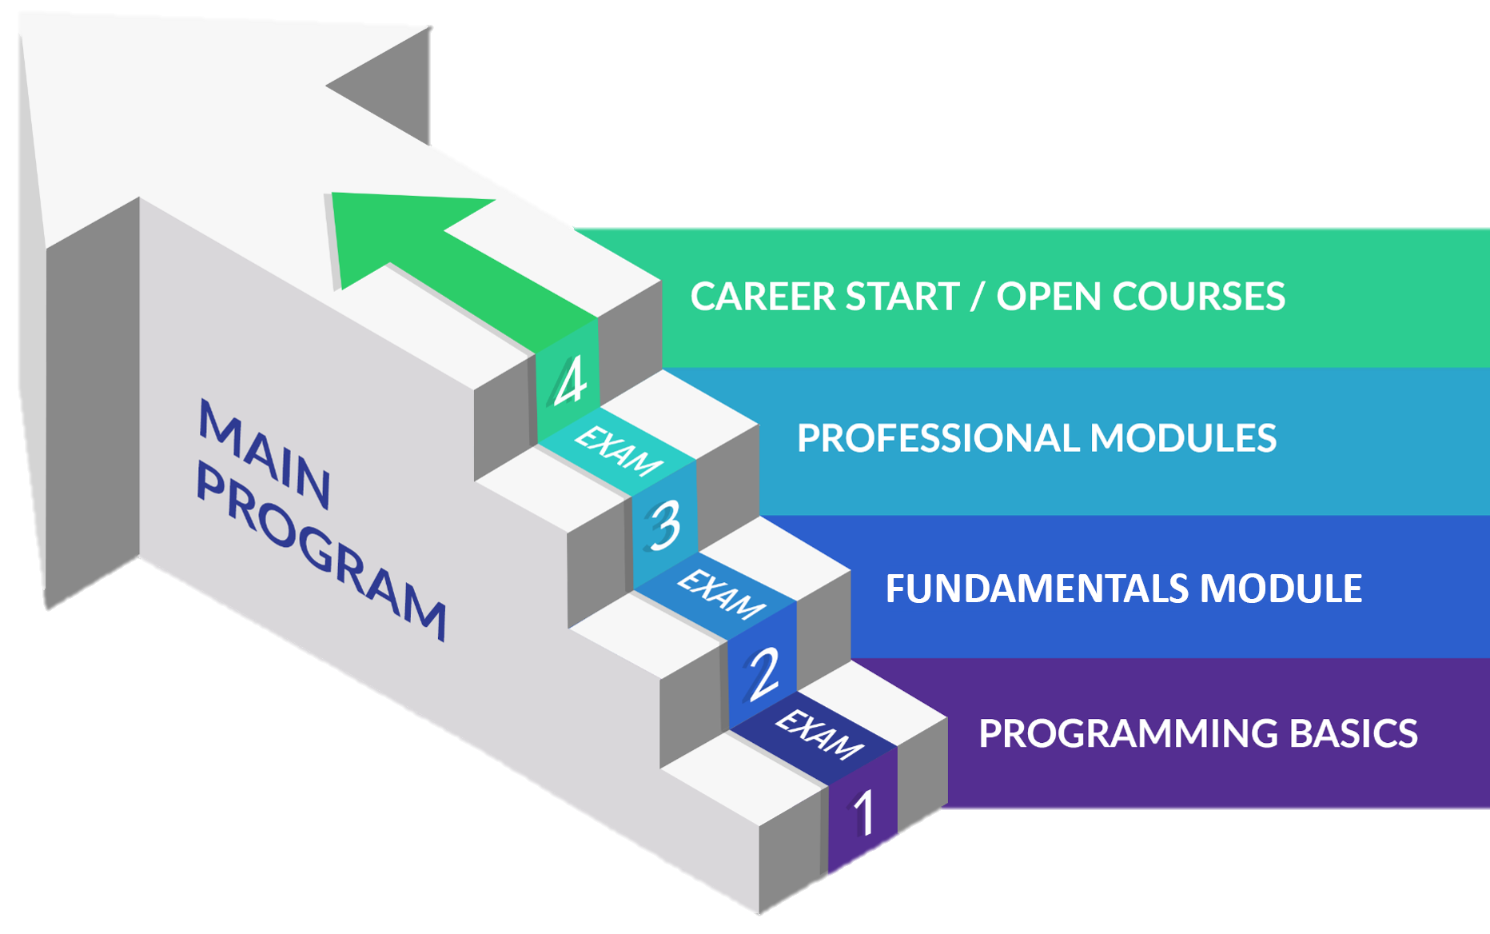
Software Engineering: Educational Program
Learning tracks: C#, Java, JavaScript, Python

Slide 37
Curriculum
Entry Module
Programming Basics
2 months
Fundamental Module
Fundamentals Module
4 months
Professional Modules
Java
C#
Python
JS
12-16 months
https://softuni.bg/trainings/courses

Slide 38
Questions?
Notes:
38

Slide 39
Trainings @ Software University (SoftUni)
Software University – High-Quality Education, Profession and Job for Software Developers
softuni.bg, about.softuni.bg
Software University Foundation
softuni.foundation
Software University @ Facebook
facebook.com/SoftwareUniversity
Software University Forums
forum.softuni.bg
Notes:
39

Slide 40

License
This course (slides, examples, demos, exercises, homework, documents, videos and other assets) is copyrighted content
Unauthorized copy, reproduction or use is illegal
© SoftUni – https://about.softuni.bg/
© Software University – https://softuni.bg
Notes:
40

